Slide 1
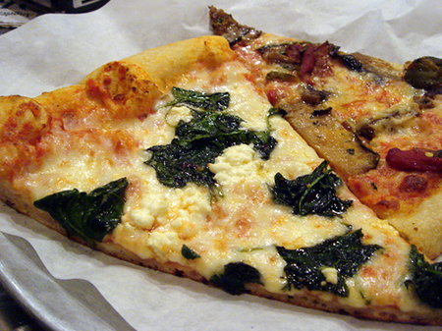
Topic: Rational Numbers EQ: How do I multiply and divide rational numbers?

Slide 2

LESSON OBJECTIVES
I will multiply and divide fractions (find a fraction of a fraction).
I will divide fractions by finding the inverse.

Slide 3
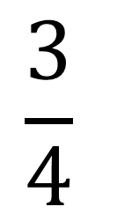
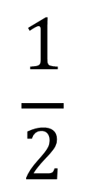
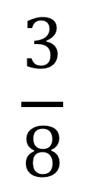
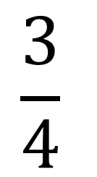
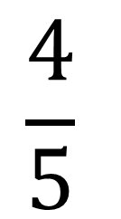
Daily Review
$$\frac{1}{2}$$
$$\frac{3}{4}$$
$$\frac{4}{5}$$
$$\frac{3}{4}$$
$$\frac{3}{8}$$
+
-
+
2

Slide 4
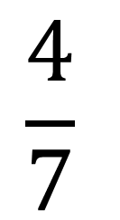
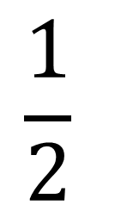
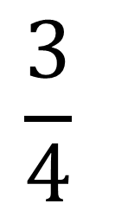
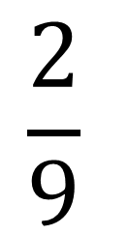
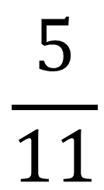
Daily Review
$$\frac{3}{4}$$
$$\frac{4}{7}$$
$$\frac{4}{5}$$
$$\frac{5}{11}$$
$$\frac{2}{9}$$
$$\frac{1}{2}$$
+
-
3
+

Slide 5

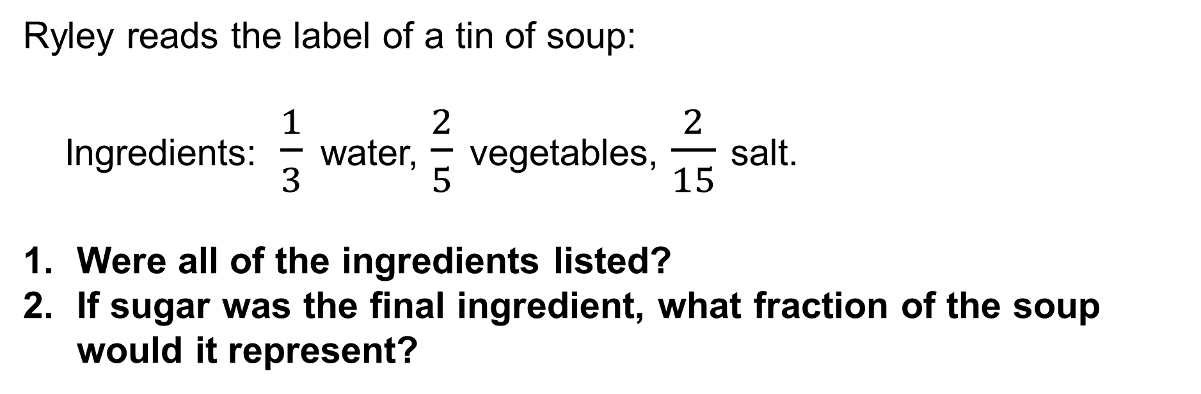
Daily Review
Ryley reads the label of a tin of soup:
Ingredients:$\frac{1}{3}$ water, $\frac{2}{5}$ vegetables, $\frac{2}{15}$ salt.
Were all of the ingredients listed?
If sugar was the final ingredient, what fraction of the soup would it represent?

Slide 6
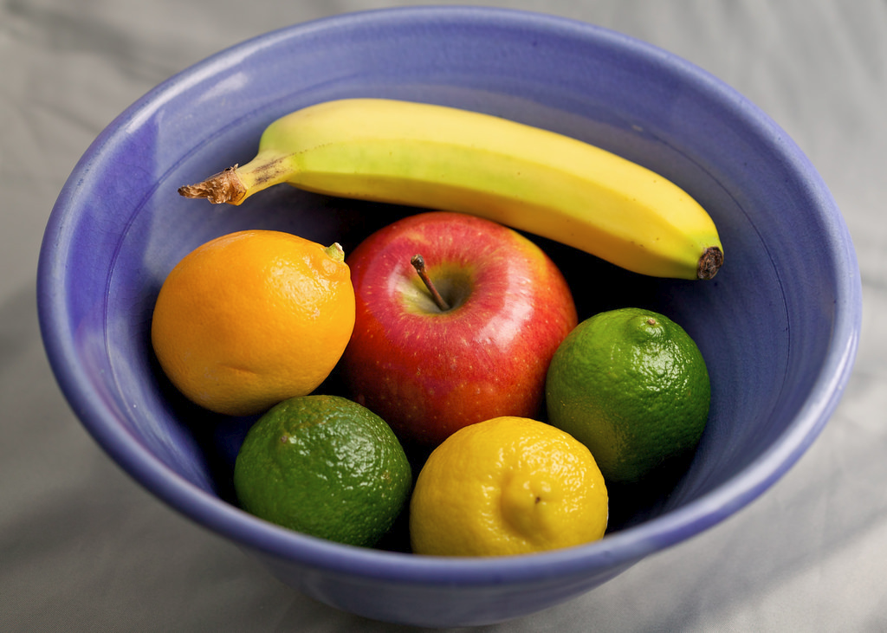
Back to primary school…
What is 3 lots of 6?
3 x 6 = 18

Slide 7





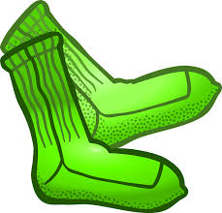
Back to primary school…
4 lots of 6
4 x 6 = 24
3 lots of 6
3 x 6 = 18
5 lots of 2
5 x 2 = 10
When you see ‘lots of’ or ‘of’
replace it with a multiplication sign (x).

Slide 8


Finding a Fraction of a Fraction
(Multiplying Fractions)
Multiply the numerators
1 x 3
3
$$\frac{1}{2}$$
$$\frac{3}{4}$$
x
=
=
2 x 4
8
Multiply the denominators

Slide 9
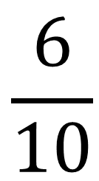
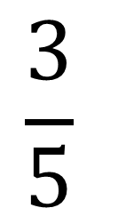
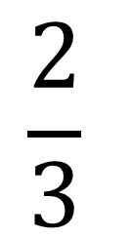
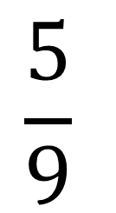
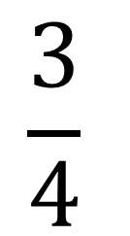
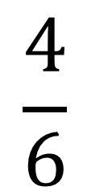
Finding a Fraction of a Fraction
(Multiplying Fractions)
$$\frac{3}{5}$$
$$\frac{4}{6}$$
$$\frac{3}{4}$$
$$\frac{5}{9}$$
$$\frac{2}{3}$$
$$\frac{6}{10}$$
x
x
OF
Multiply the numerators
Multiply the denominators

Slide 10
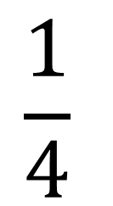
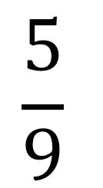
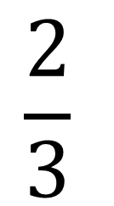
Finding a Fraction of a Whole
(Multiplying Fractions)
$$\frac{1}{4}$$
$$\frac{2}{3}$$
$$\frac{5}{9}$$
3
4
6
x
OF
OF
Multiply the numerators
Multiply the denominators

Slide 11
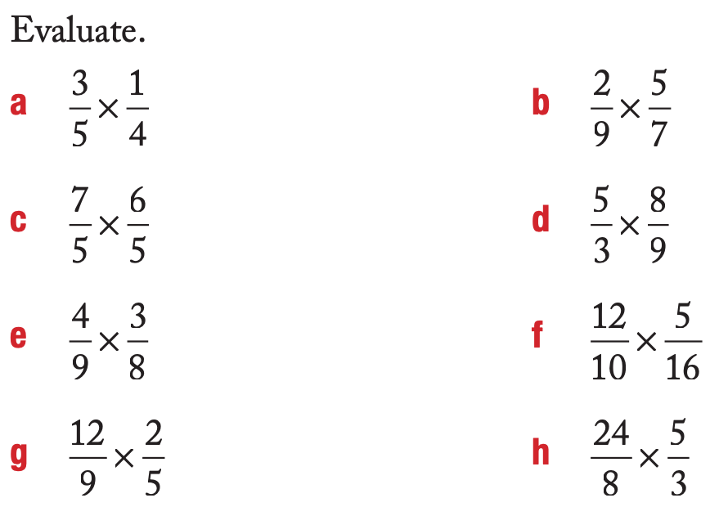
Independent Practice

Slide 12
Finding the Inverse
An inverse is the opposite of something.
To invert something is to put it upside down or in the opposite position.
The inverse of UP is…
DOWN!

Slide 13
Finding the Inverse
An inverse is the opposite of something.
To invert something is to put it upside down or in the opposite position.
The inverse of LEFT is…
RIGHT

Slide 14




Finding the Inverse
The inverse of ADDITION is…
SUBTRACTION
The inverse of DIVISION is…
MULTIPLICATION

Slide 15

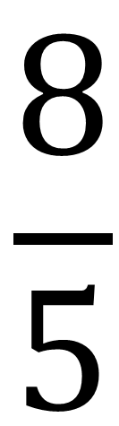
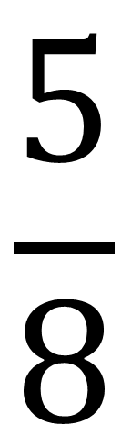
Finding the Inverse
The inverse of this fraction is…
$$\frac{5}{8}$$
$$\frac{8}{5}$$
SWITCH IT!

Slide 16
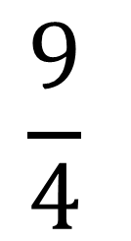
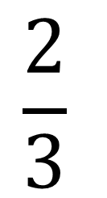
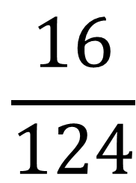
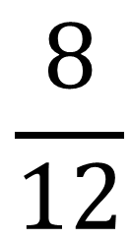
Finding the Inverse
Find the inverse of these fractions.
$$\frac{2}{3}$$
$$\frac{9}{4}$$
$$\frac{8}{12}$$
$$\frac{16}{124}$$

Slide 17
LEAVE IT
SWAP IT
SWITCH IT

Slide 18
https://wes.nwcomplex.org/apps/video/watch.jsp?v=120450

Slide 19
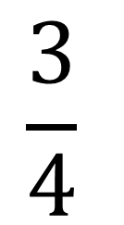
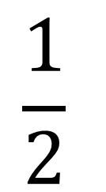
Dividing Fractions
$$\frac{1}{2}$$
$$\frac{3}{4}$$
÷
One divided by two, divided by three divided by four…
WHAT?
How do we solve it?

Slide 20
LEAVE IT
Invert it
SWAP IT
SWITCH IT

Slide 21

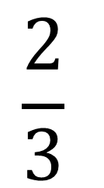
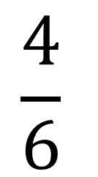
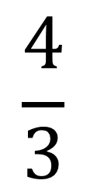
Dividing Fractions
$$\frac{1}{2}$$
$$\frac{3}{4}$$
÷
1.
Leave it
2.
Swap it
$$\frac{4}{3}$$
=
x
3.
Switch it
$$\frac{4}{6}$$
$$\frac{2}{3}$$
=
=

Slide 22
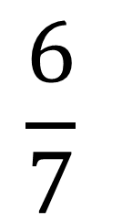
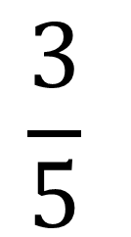
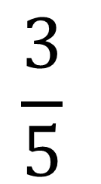
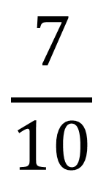
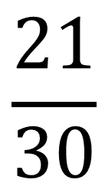
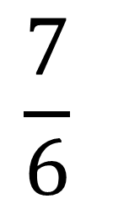
Dividing Fractions
$$\frac{3}{5}$$
$$\frac{6}{7}$$
÷
1.
Leave it
2.
Swap it
$$\frac{3}{5}$$
$$\frac{7}{6}$$
=
x
3.
Switch it
$$\frac{21}{30}$$
$$\frac{7}{10}$$
=
=

Slide 23
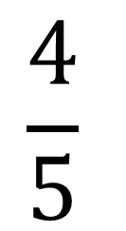
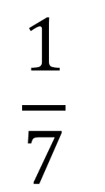
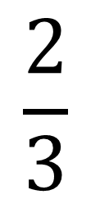
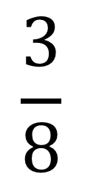
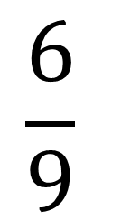
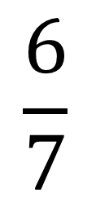
Dividing Fractions
$$\frac{4}{5}$$
$$\frac{2}{3}$$
$$\frac{6}{9}$$
$$\frac{6}{7}$$
$$\frac{1}{7}$$
$$\frac{3}{8}$$
÷
÷
÷
Leave it
Swap it
Switch it

Slide 24
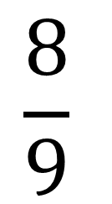

Dividing Fractions
$$\frac{2}{3}$$
$$\frac{8}{9}$$
$$\frac{12}{5}$$
2
÷
5
11
÷
÷
Leave it
Swap it
Switch it

Slide 25

What have we learnt today?
Lesson Objectives:
I will multiply fractions (find a fraction of a fraction).
What do you do when you see the word ‘of’?
Replace it with x

